Slide 1
Employee Data Analysis using Excel
STUDENT NAME: R.Anuradha singh
REGISTER NO: 312209376
DEPARTMENT: B.COM(General)
COLLEGE : ANNA ADARSH COLLEGE FOR WOMEN

Slide 2
PROJECT TITLE
Employee Performance Analysis using Excel

Slide 3


AGENDA
Problem Statement
Project Overview
End Users
Our Solution and Proposition
Dataset Description
Modelling Approach
Results and Discussion
Conclusion
3/21/2024 Annual Review

Slide 4

PROBLEM STATEMENT
It is about the employee performance analysis to know about employee situation if it has a low performance help to motivate the employee.

Slide 5

PROJECT OVERVIEW
Evaluate employee performance by analyzing multiple factors such as gender and performance rating , utilizing employee data or a generated performance code.
.

Slide 6
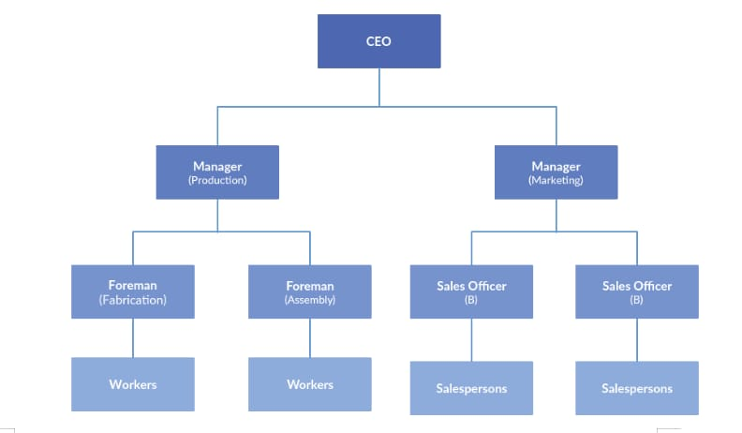

WHO ARE THE END USERS?

Slide 7

OUR SOLUTION AND ITS VALUE PROPOSITION
Using Conditional Formatting : Missing figure
Filter: Remove
Pivot: Summary
Graph: Data Visualization

Slide 8
Dataset Description
EMPLOYEE=KARGLE
26-FEATURES
9-FEATURES
EMPLOYEE ID- NUM NAME- TEXT
EMPLOYEE TYPE
PERFORMANCE SCORE
GENDER- MALE, FEMALE
EMPLOYEE RATING- NUM

Slide 9

THE "WOW" IN OUR SOLUTION
PERFORMANCE= IFS(Z8>=5,”VERY HIGH”, Z8>=4,”HIGH”, Z8>=3,”MED”, TRUE,”LOW”)
3/21/2024 Annual Review
9

Slide 10
MODELLING
1.Data Collection
Downloaded from the Edunet Dashboard.
Gathered the employee performance score
2. Feature Collection:
Identified performance levels
Removed blank columns
3. Performance Levels:
Determined performance scores using formulas
Defined them using a pivot table.
4. Summary:
Downloaded the employee dataset from the dashboard and deleted blank columns
Create performance levels using formulas
Defined them with a pivot table.
10

Slide 11
RESULTS
11

Slide 12
conclusion
The employee dataset, as analyzed by me using Excel, shows that the organization is performing well overall. While most employees exhibit good performance, a few need improvement. To help them develop, additional tasks can be assigned. This conclusion highlights the key findings from the dataset.

